Slide 1
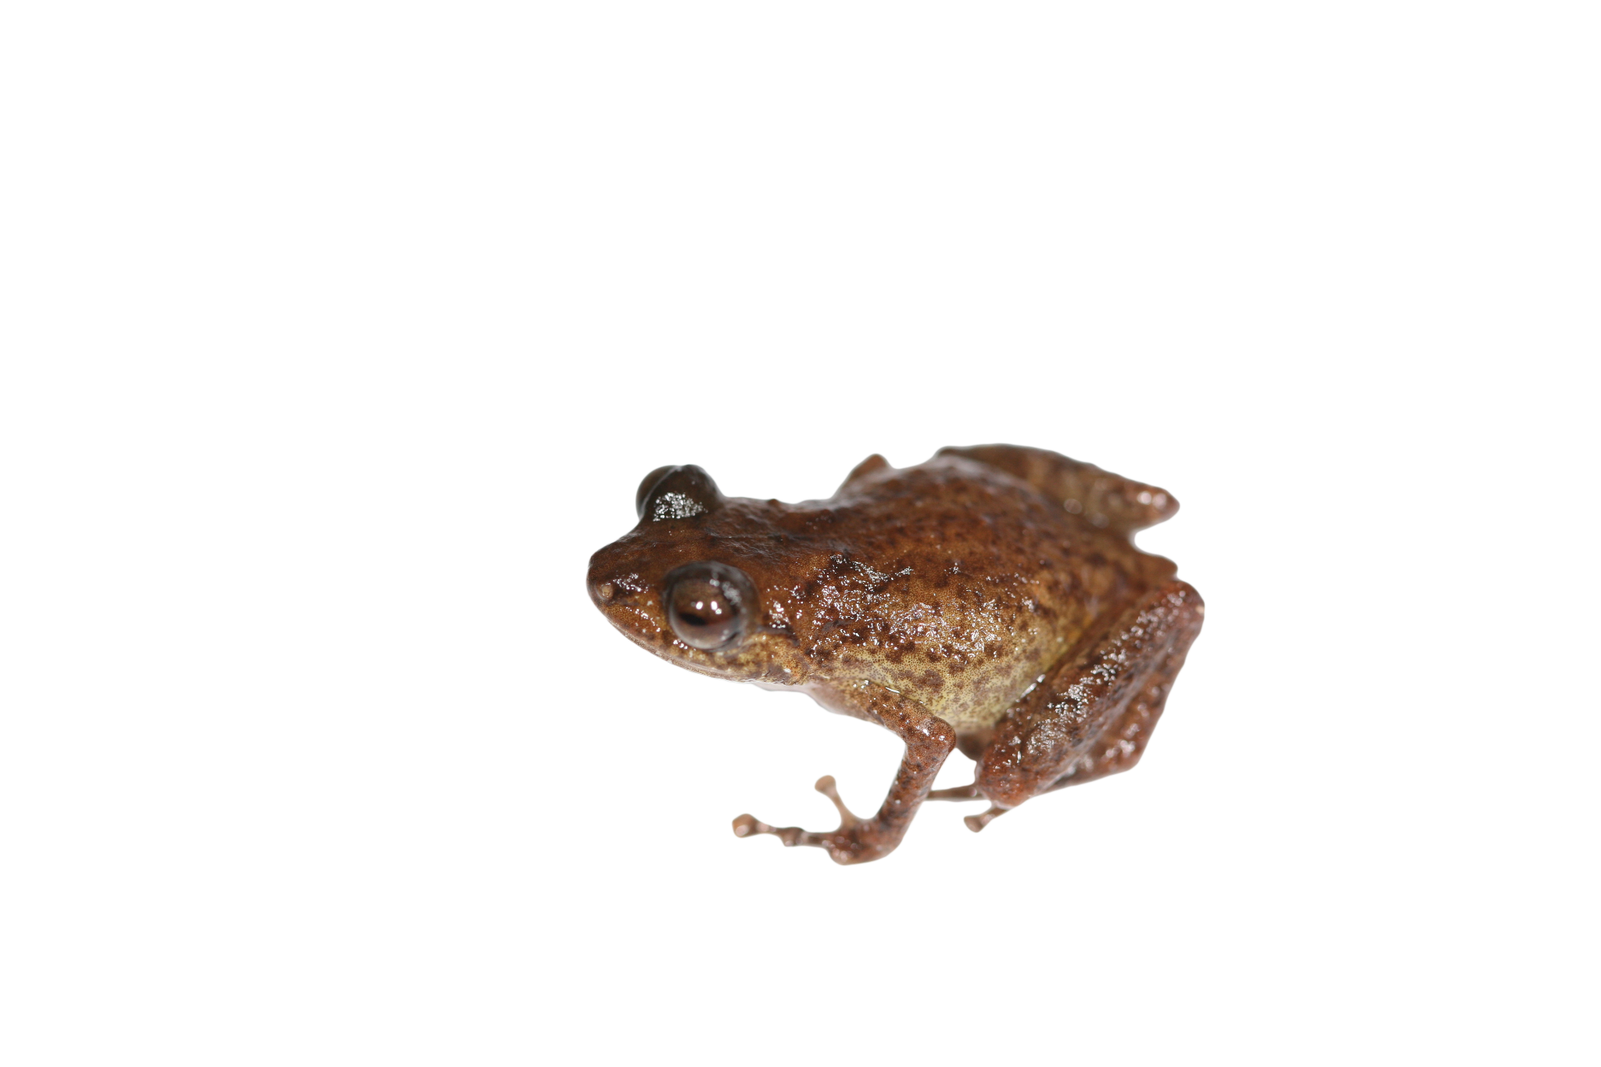
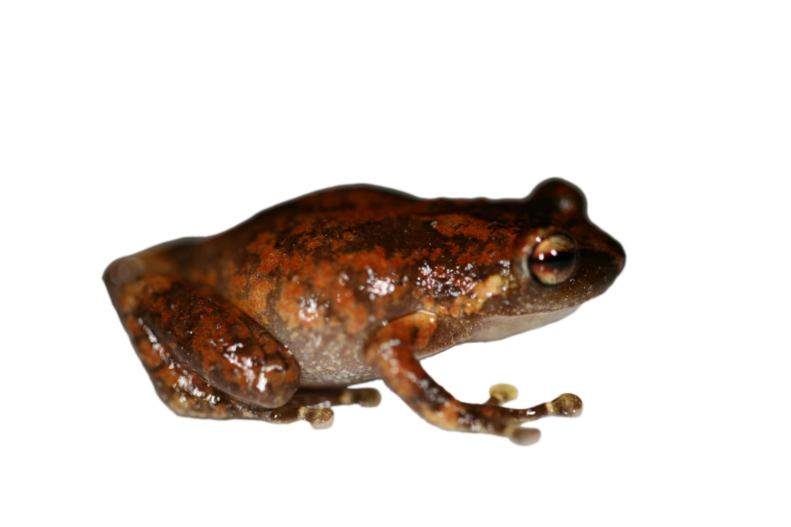

Will the True Oreophryne Stand Up?
Taxonomic resolution of the paraphyletic Oreophryne and strong evidence for independent evolution of arboreality in Asterophryinae frogs
Allison Fisher arfisher@hawaii.edu
Ke Cao kc629@hawaii.edu
Marguerite Butler mbutler@hawaii.edu
Butler Lab butlerlab.org
University of Hawaii at Manoa

Slide 2
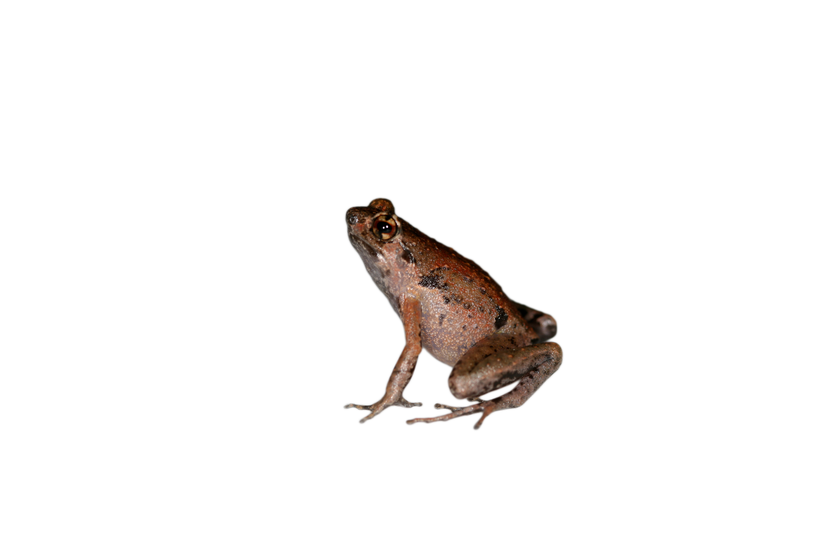
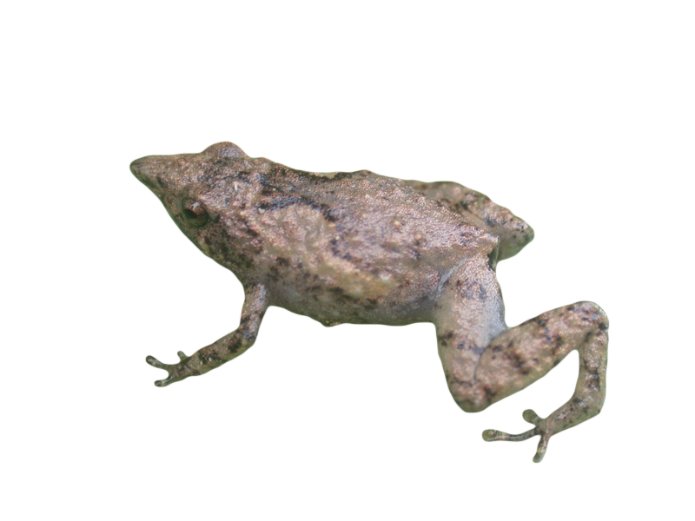
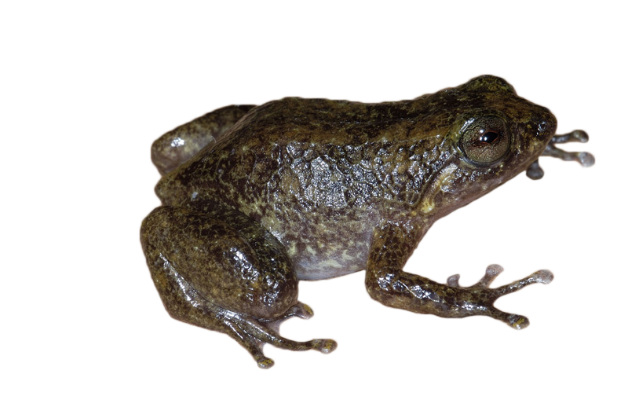
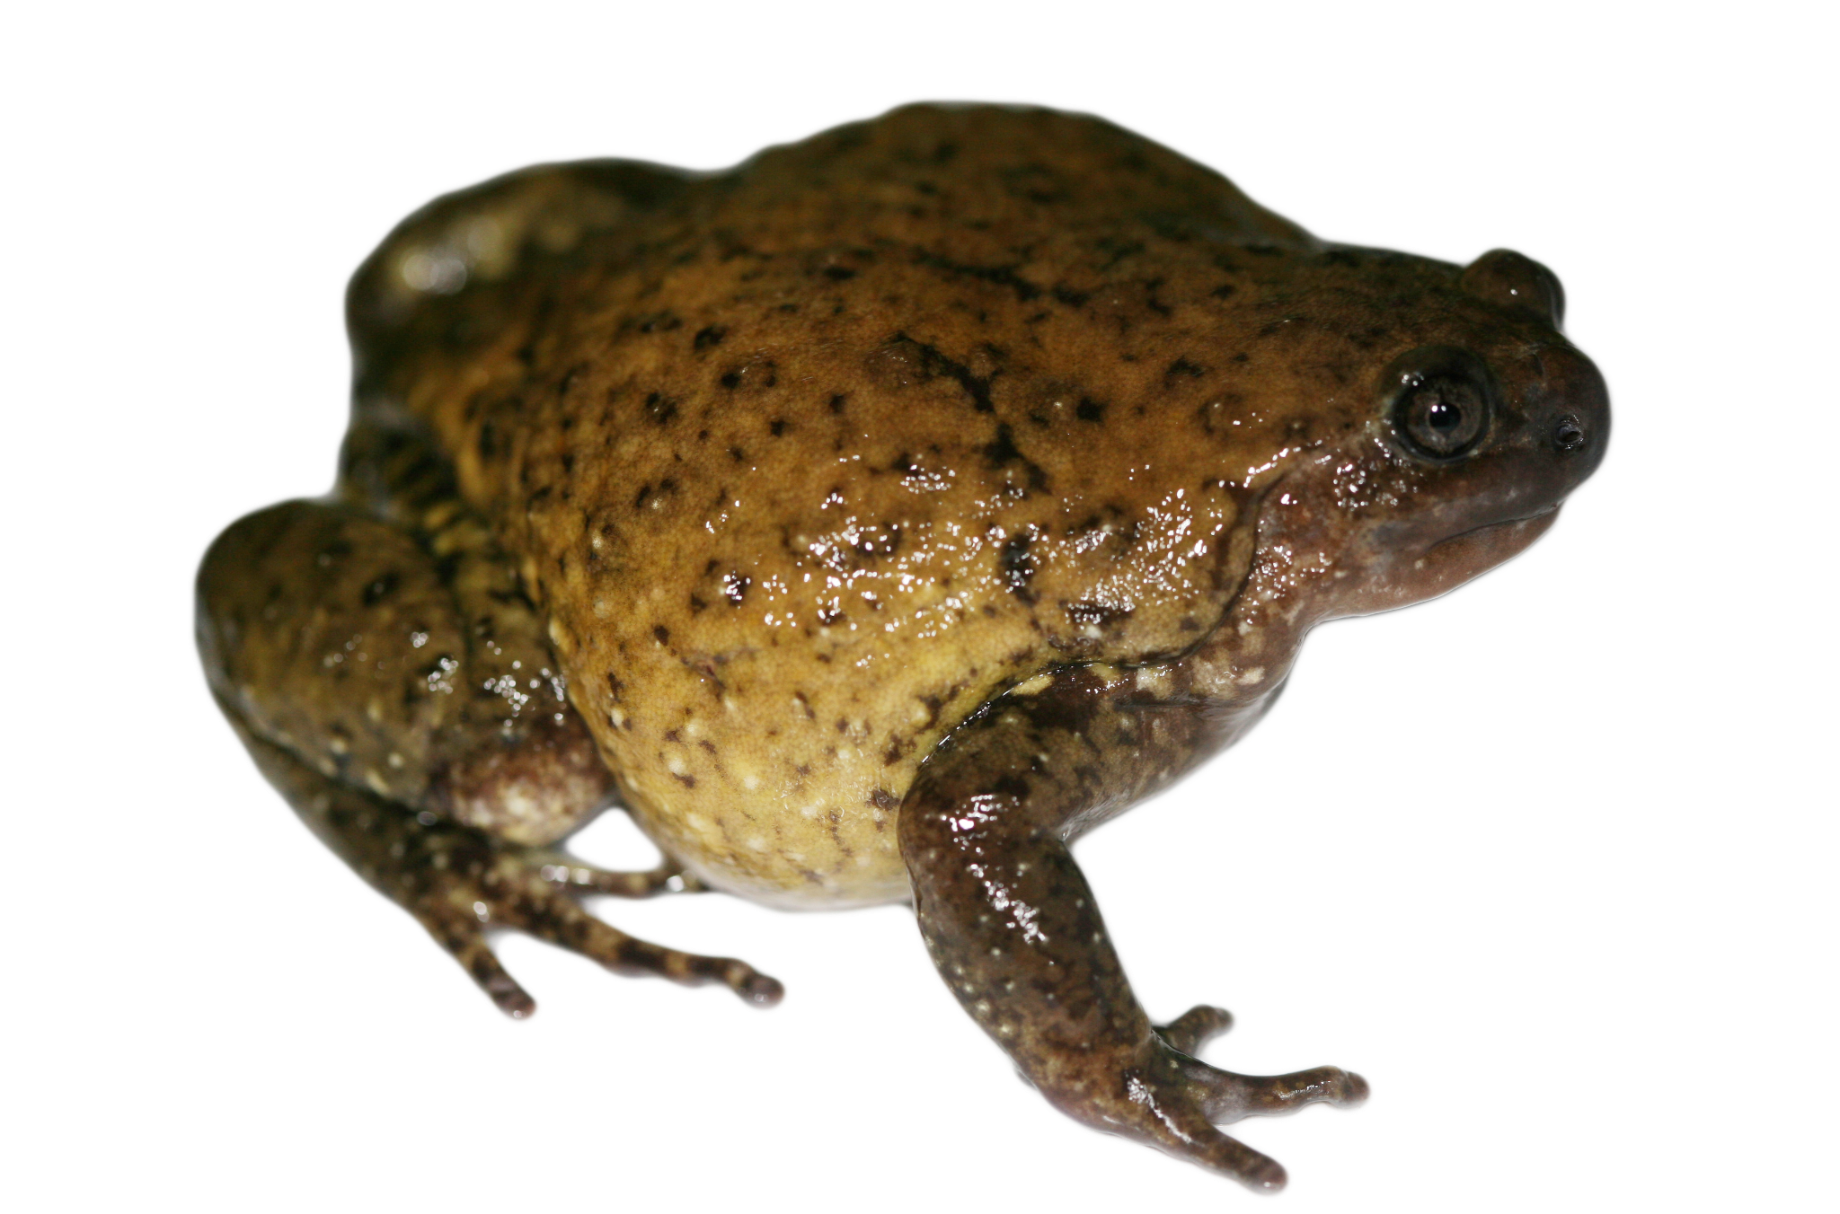
Asterophryinae subfamily of Papua New Guinea
Arboreal
Adaptive radiation (~20MY)
=> diversity of lifestyles, niche conservatism
Terrestrial
Scansorial
Semi-aquatic
Fossorial (underground)

Slide 3
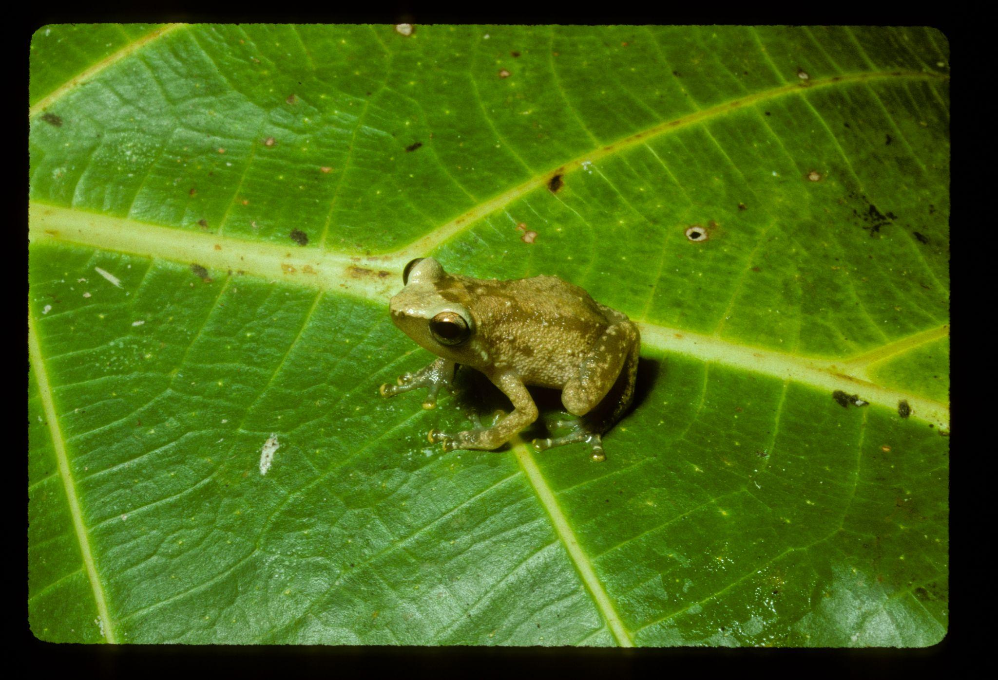
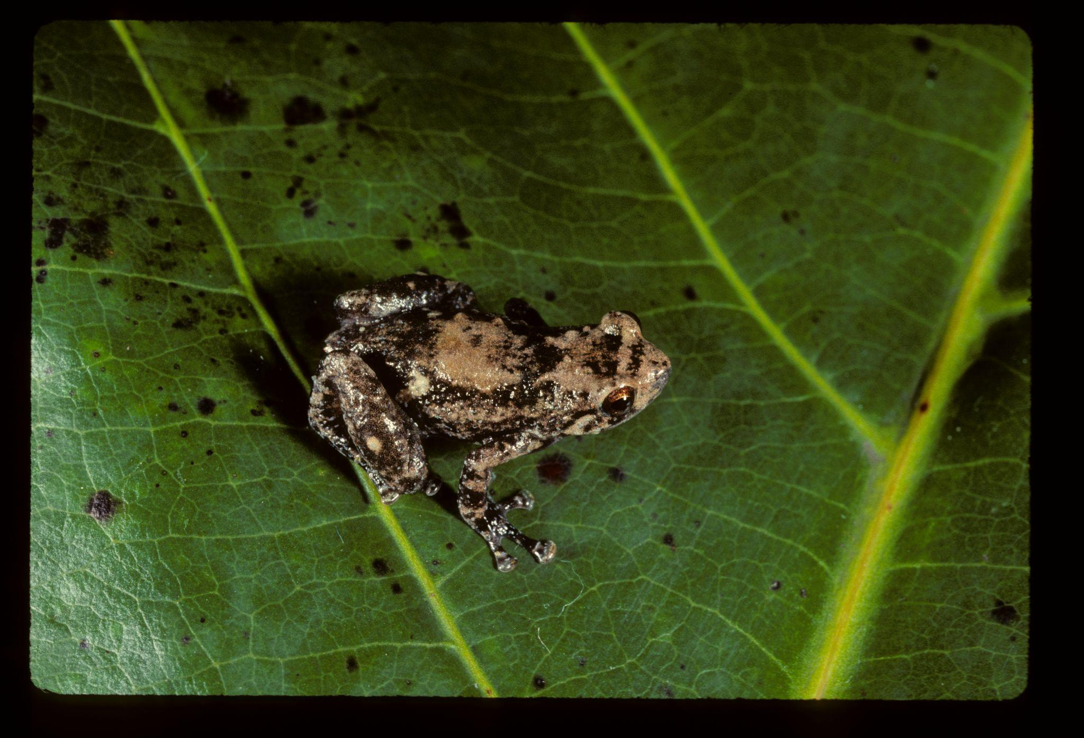
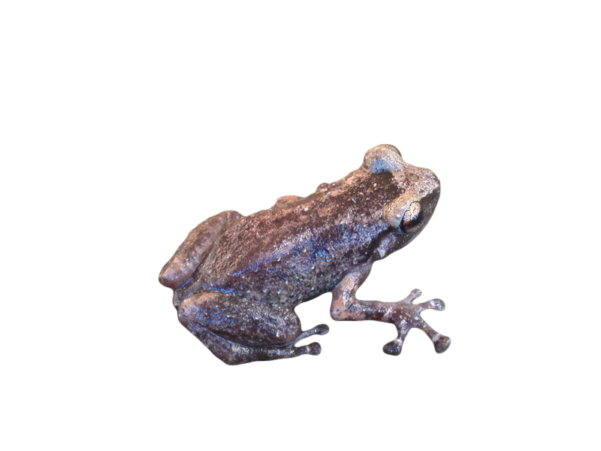
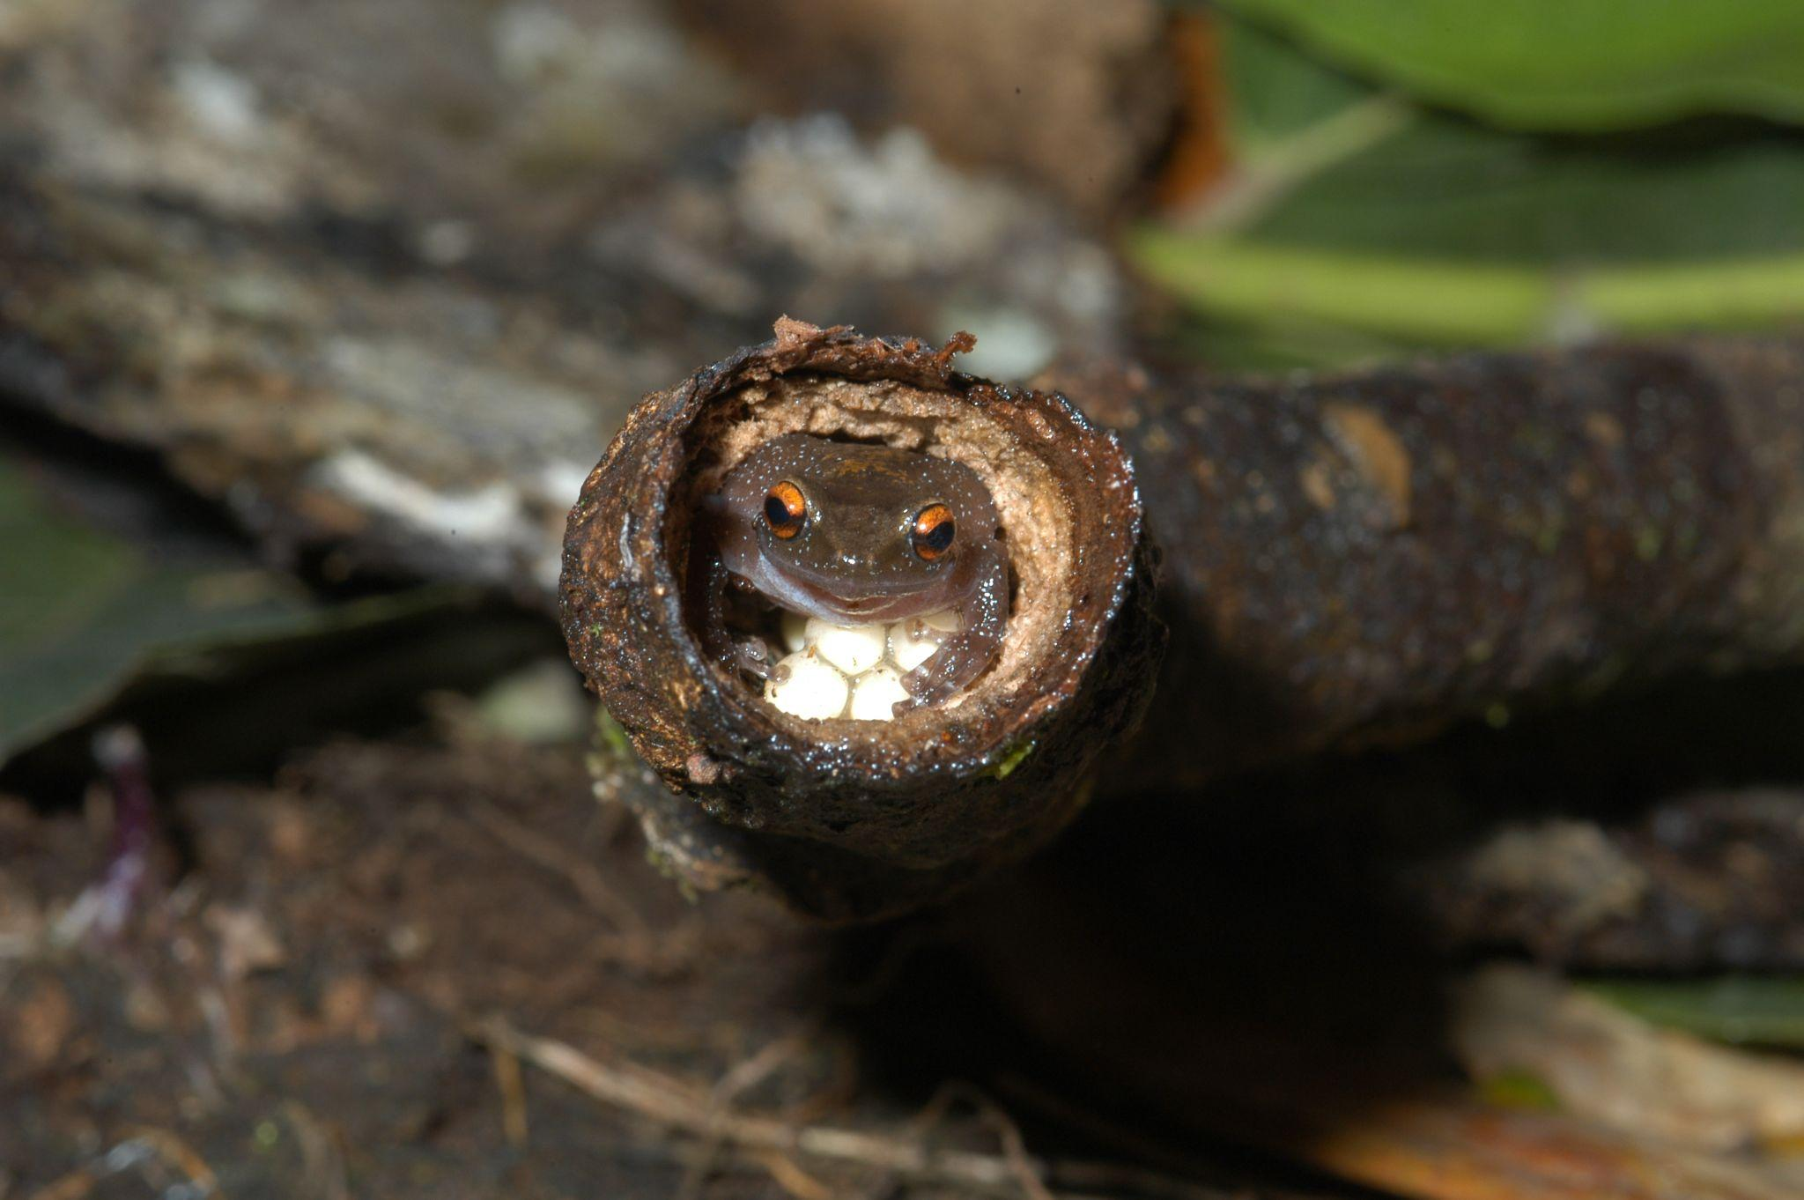
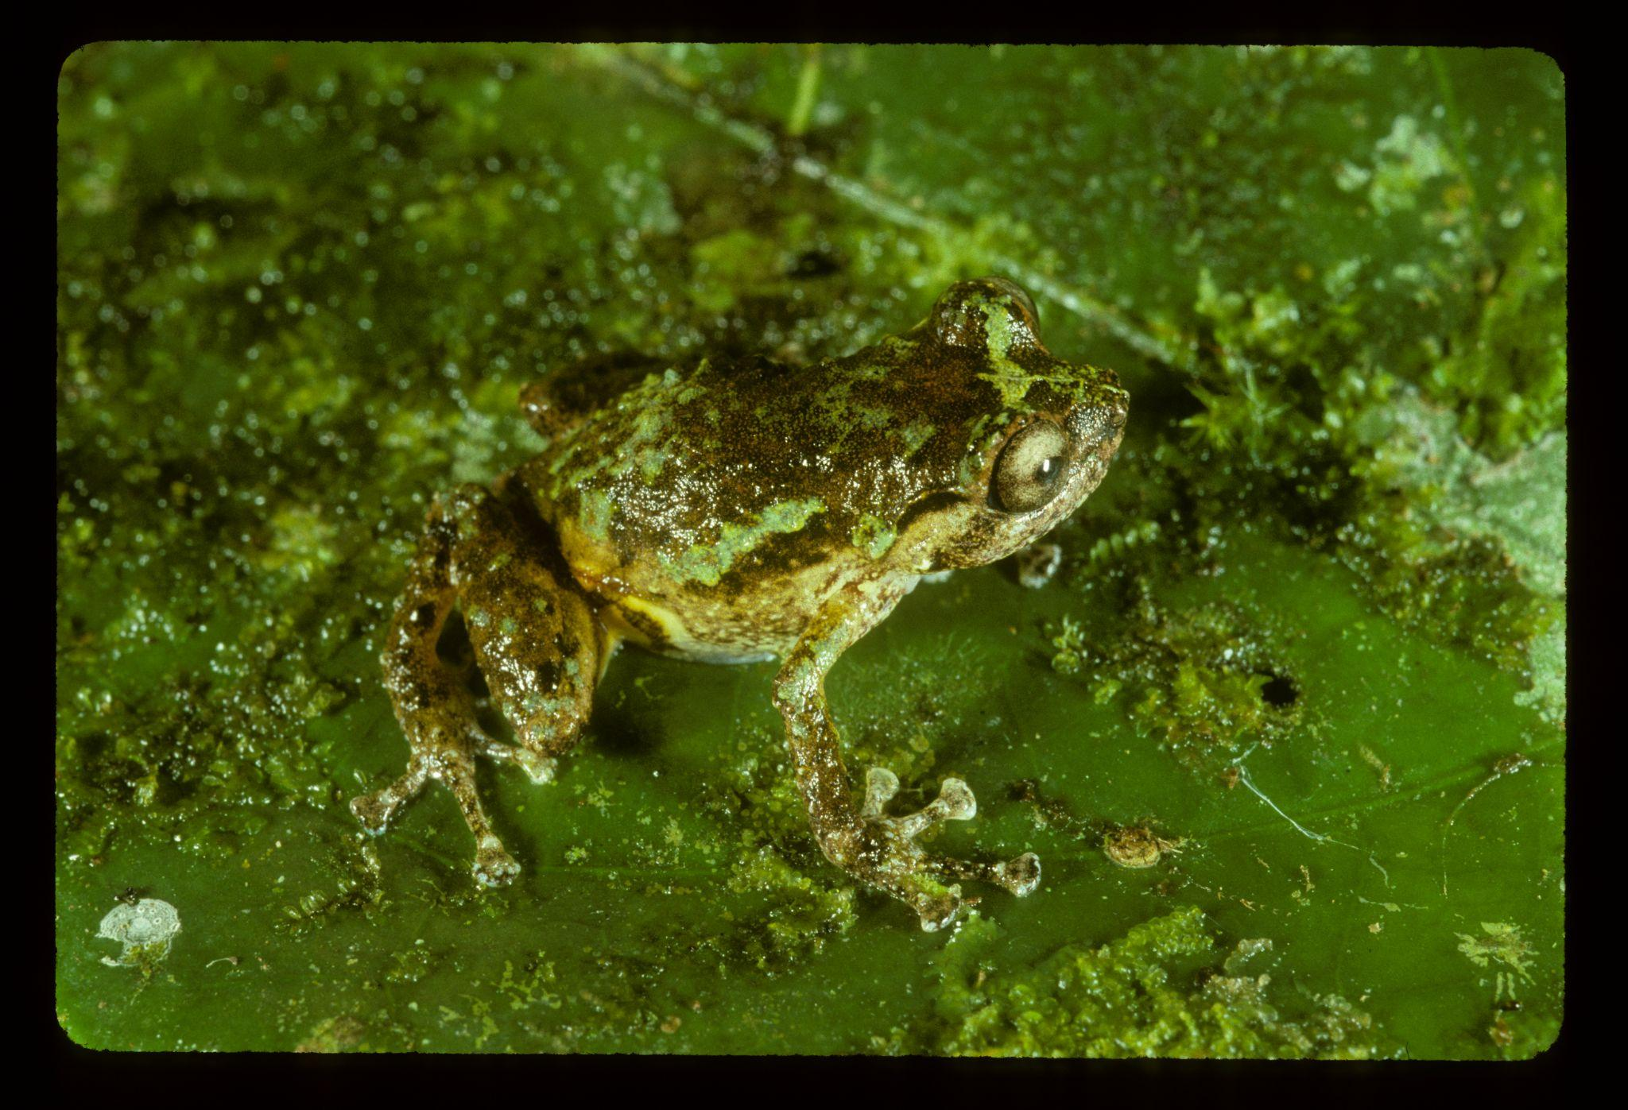
Oreophryne (Boettger 1895)
Arboreal lifestyle
Small-medium body size
(SVL ~11-37mm)
Defining features relate to lifestyle

Slide 4
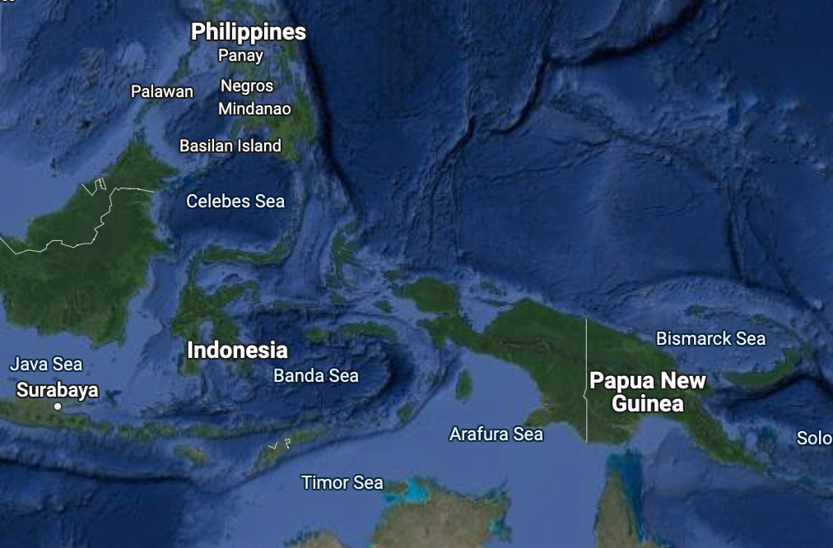
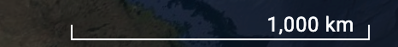
Largest genus with > 71 species
ranging > 4,000 km
But this is unusual for tiny frogs…

Slide 5
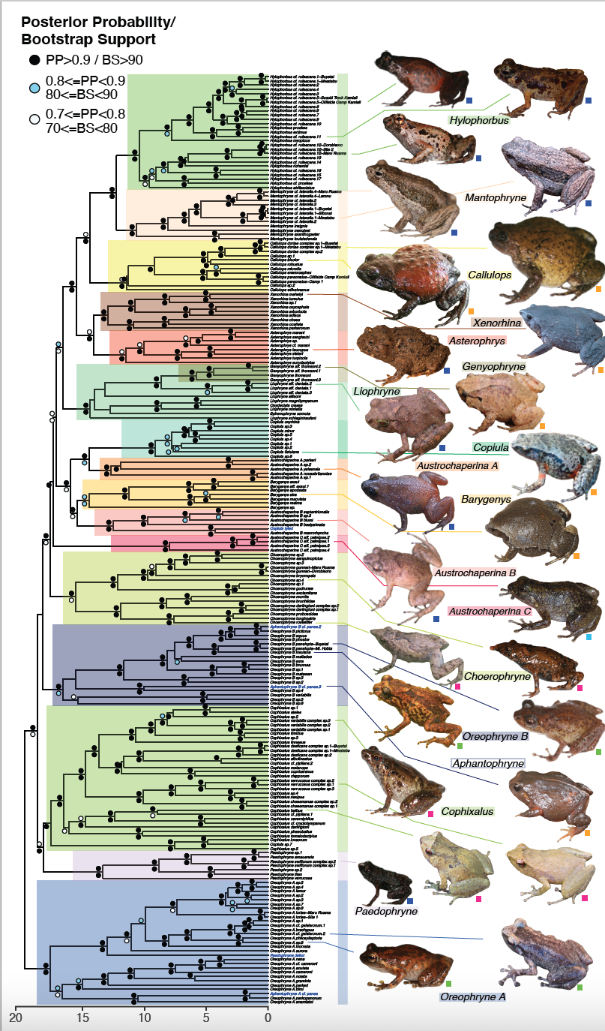
Figure from Hill et al. 2022
“Oreophryne” is actually two separate genera!
B
Oreophryne
A

Slide 6
Figure from Hill et al. 2022
Which clade is the true Oreophryne?
B
Oreophryne
A

Slide 7
Hill et al. 2022
Which clade is the true Oreophryne?
4 new samples, including the type species, Oreophryne senckenbergiana
Sequenced 5 loci
nuclear: BDNF, SIA, NXC
mitochondrial: CytB, ND4
Time-calibrated Bayesian Inference (BEAST2) and Maximum Likelihood phylogenies (IQTree2)
B
Oreophryne?
A

Slide 8
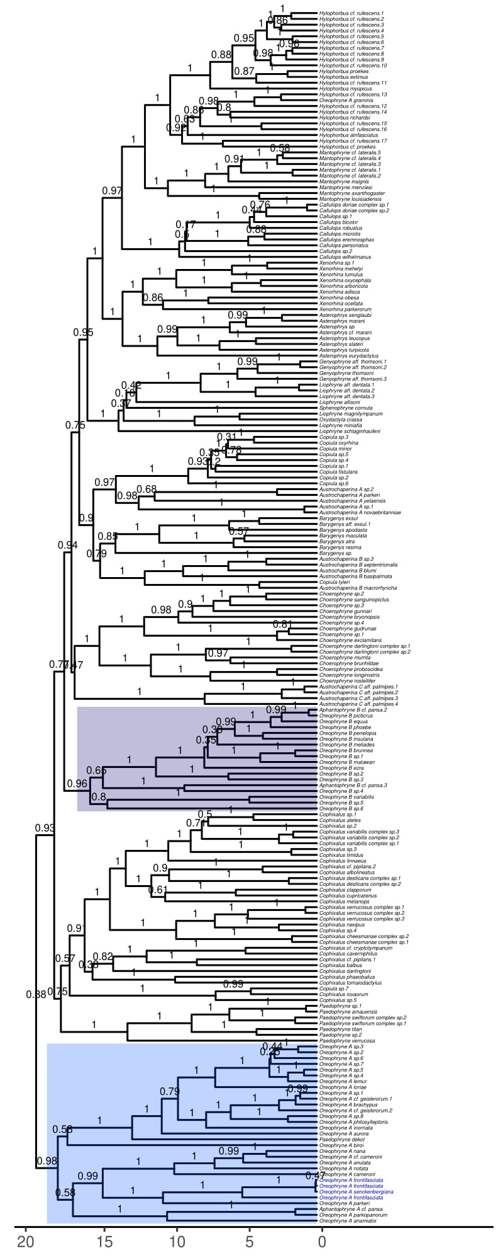
Bayesian Inference (BEAST2)
B
A

Slide 9
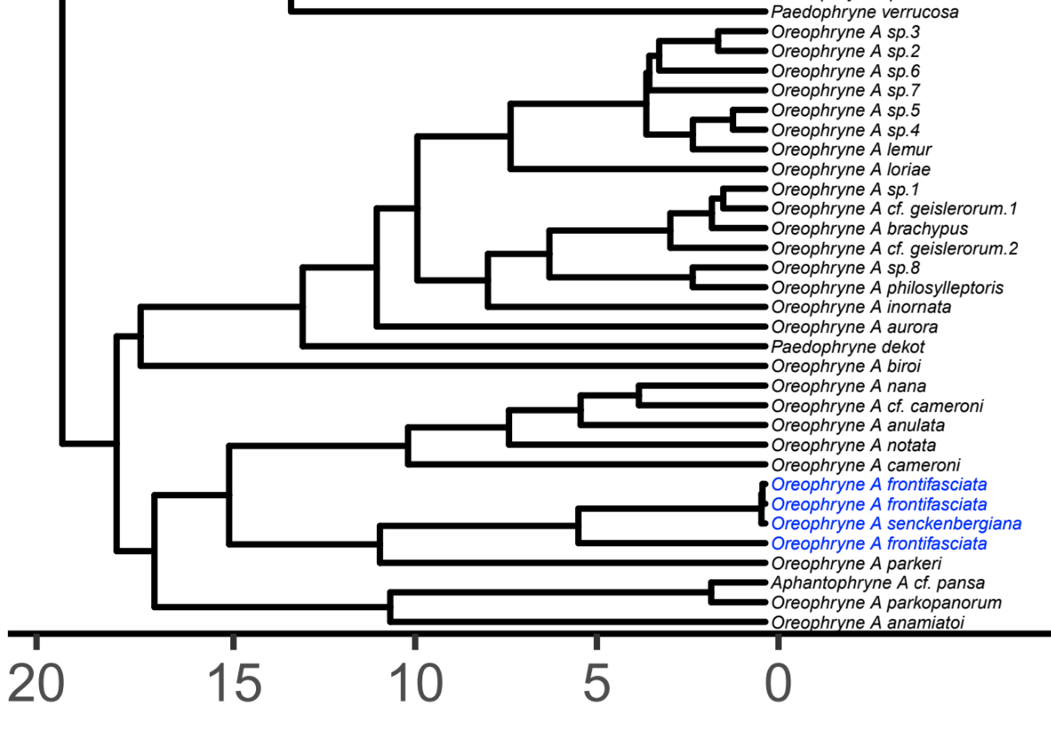
Bayesian Inference (BEAST2)
B
Type
A
MYA
Posterior Probability
>0.9
>0.7

Slide 10
Bayesian Inference (BEAST2)
Clade A is the true Oreophryne.
Thus, Oreophryne is the most basal genus.
B
Type
A
MYA
Posterior Probability
>0.9
>0.7

Slide 11
Bayesian Inference (BEAST2)
How can we define group B?
B
A

Slide 12
Bayesian Inference (BEAST2)
How can we define group B?
Introducing genus Auparoparo
Au paroparo =“Tree frog” in local language Motu
Second major group to evolve arboreal lifestyle
B
A
Type species: penelopeia

Slide 13
How does it differ from the true Oreophryne?

Slide 14
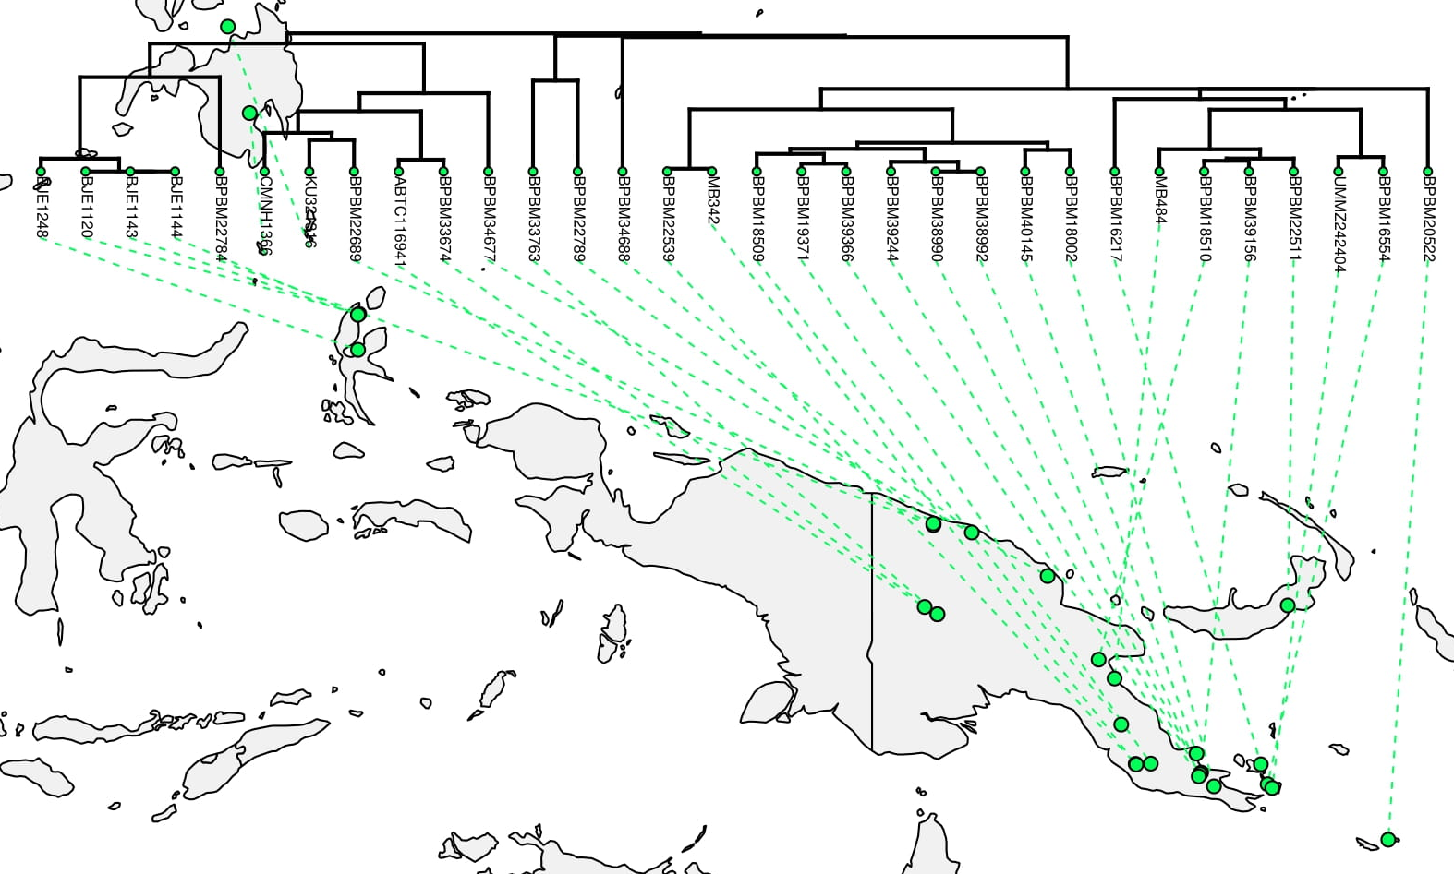
Oreophryne broadly covers PNG, New Britain, Indonesia, and the Philippines
?

Slide 15
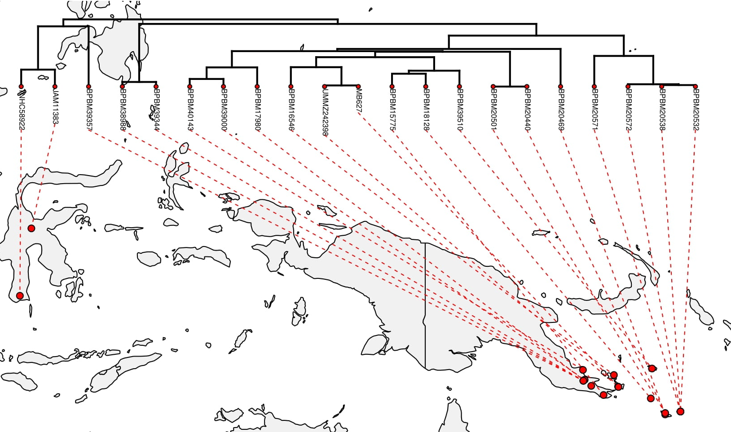
Oreophryne broadly covers PNG, New Britain, Indonesia, and the Philippines
?
?
Auparoparo is concentrated in the southeastern tip of PNG, satellite islands, and Sulawesi

Slide 16
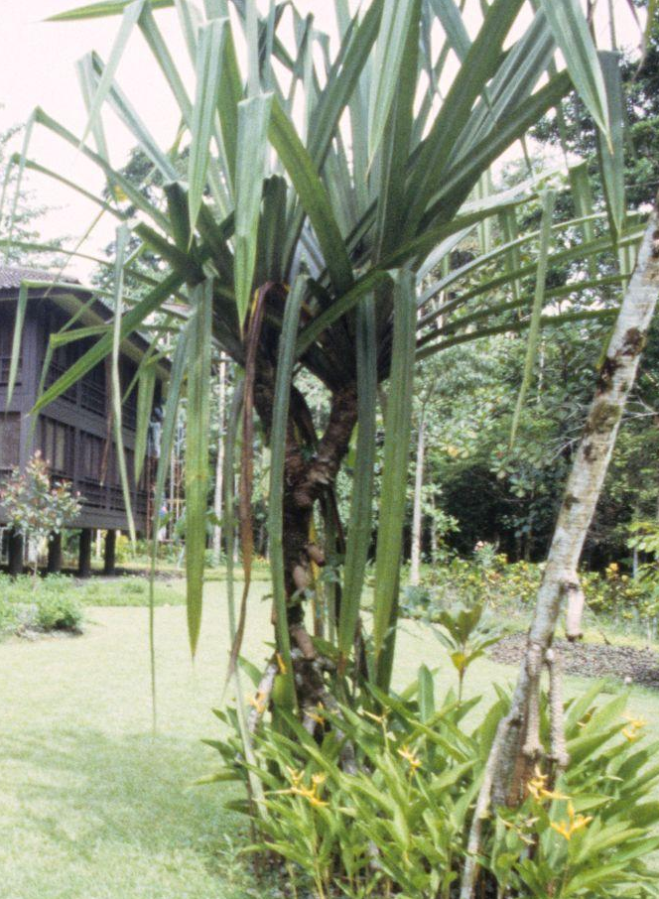
Oreophryne broadly covers PNG, New Britain, Indonesia, and the Philippines
?
But they overlap and even co-occur!
?
Auparoparo is concentrated in the southeastern tip of PNG, satellite islands, and Sulawesi

Slide 17
How do their morphologies compare?

Slide 18
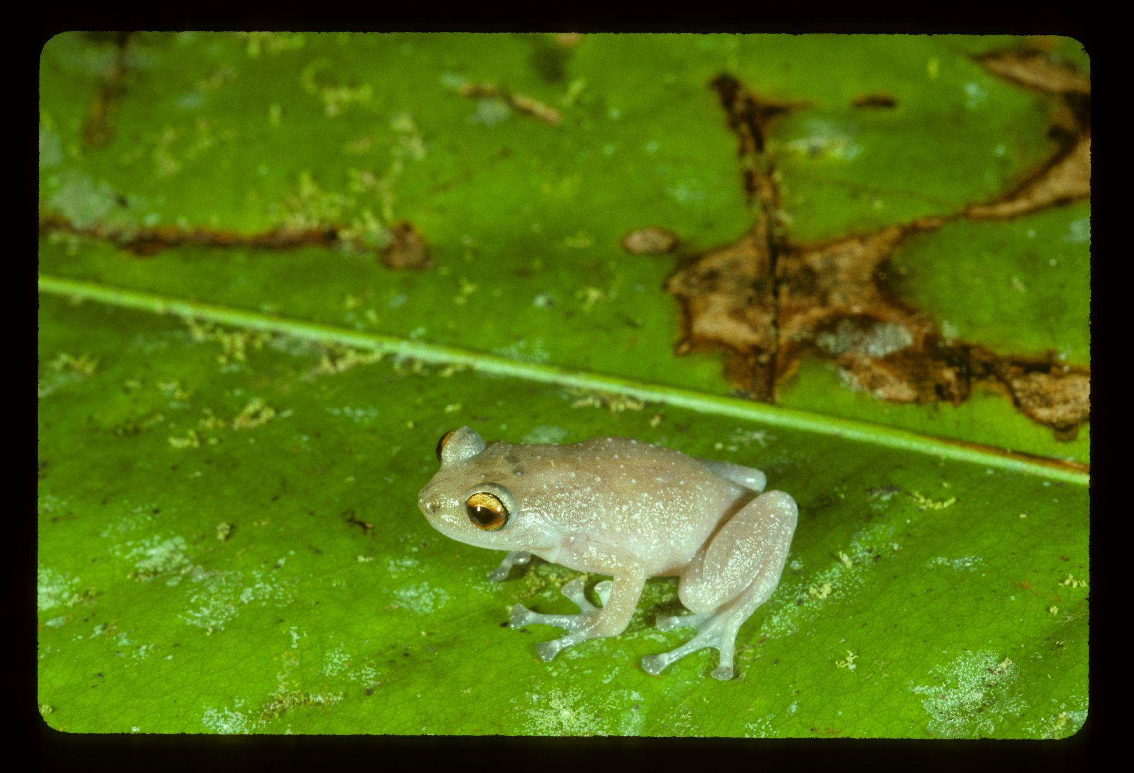
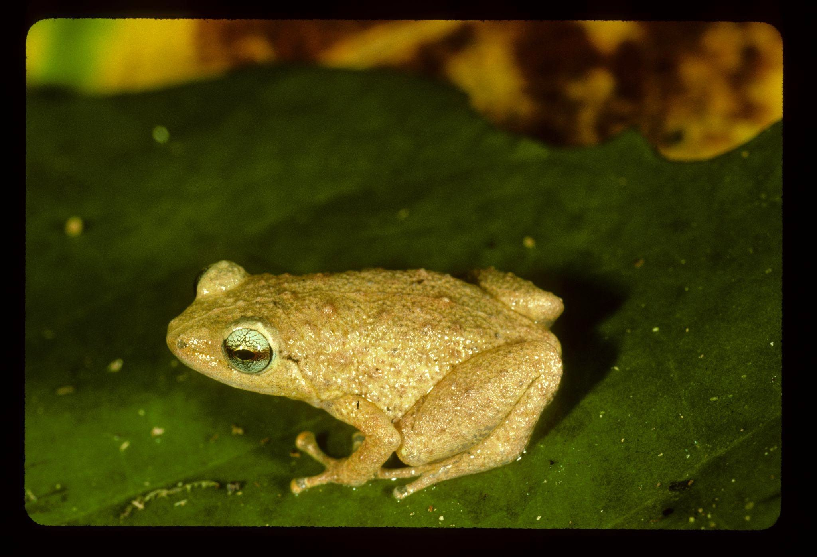
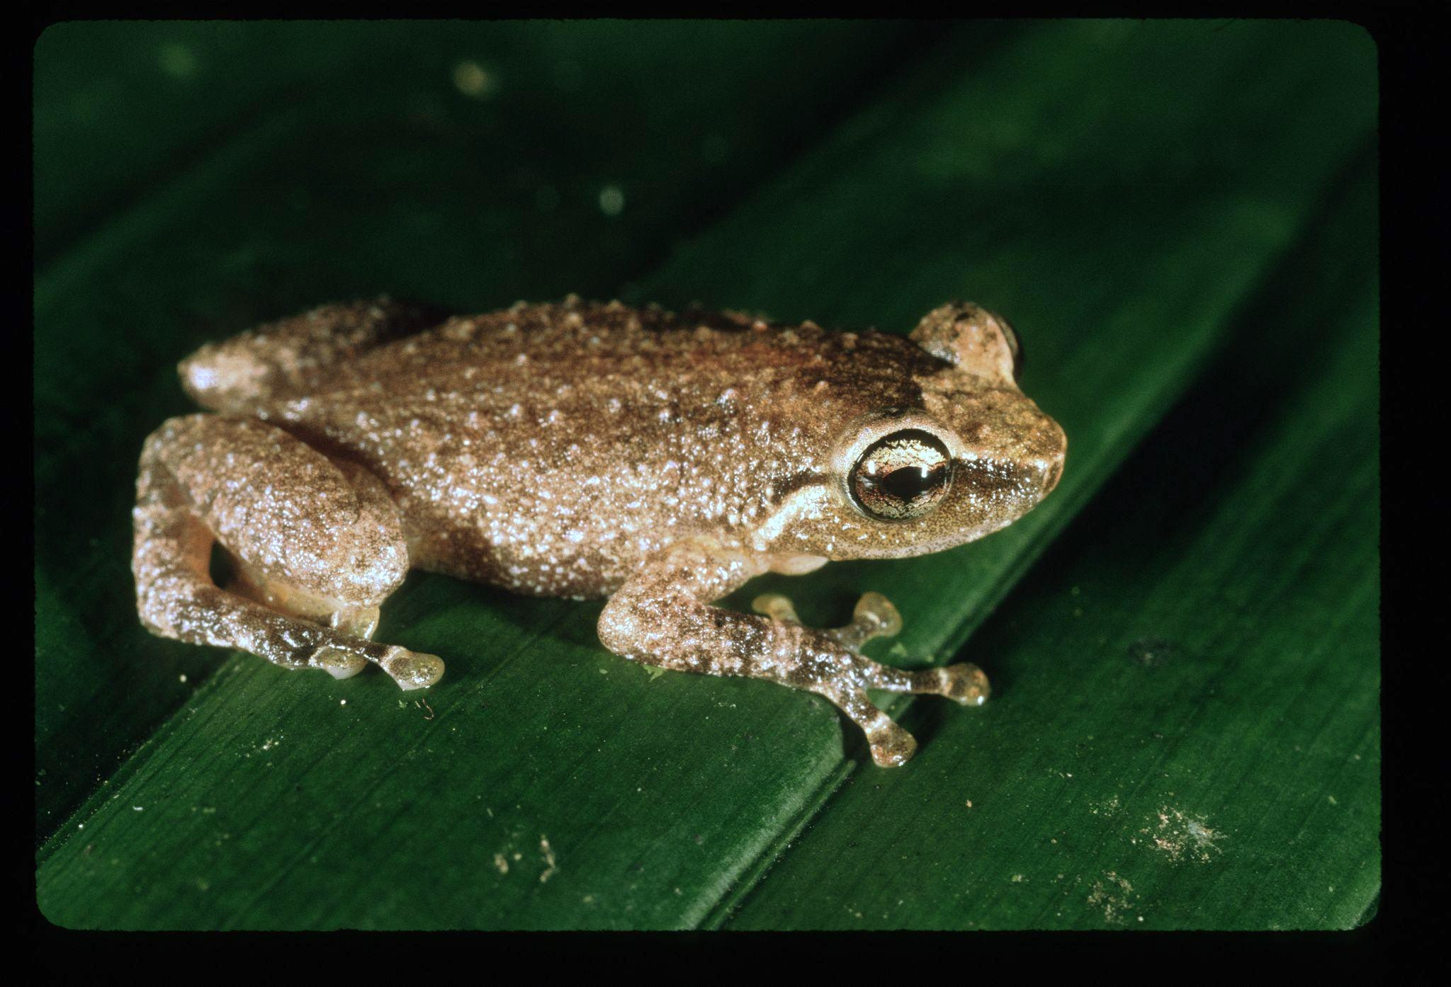
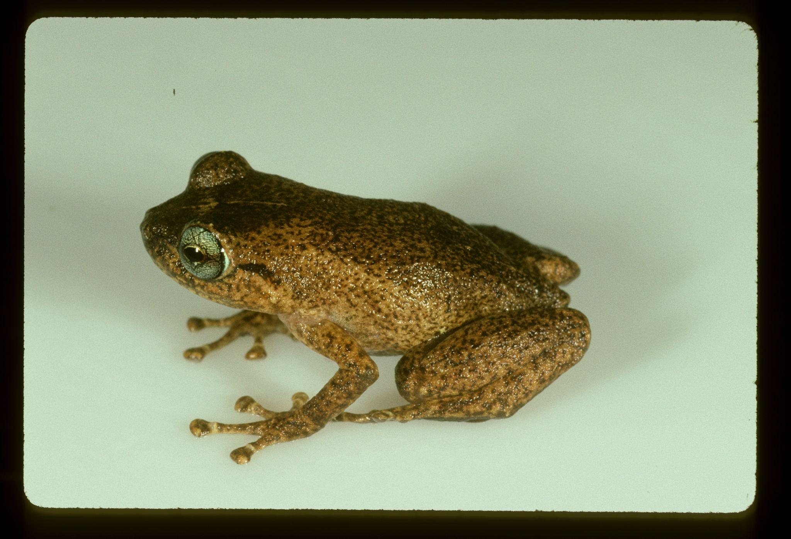
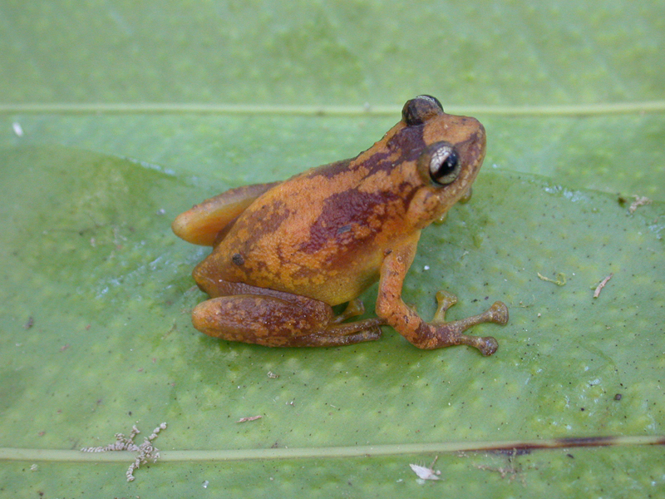
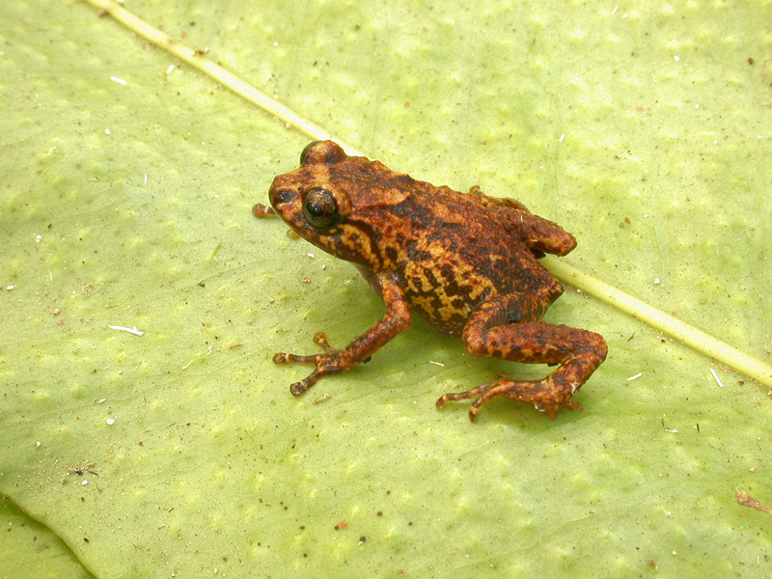
Oreophryne
Auparoparo
How do their morphologies compare?

Slide 19
Oreophryne
Auparoparo
How do their morphologies compare?
Both have:
Varied body sizes
Varied color patterns
Long limbs
Enlarged digit pads
Some toe webbing

Slide 20
Oreophryne
Auparoparo
How do their morphologies compare?
Both have:
Varied body sizes
Varied color patterns
Long limbs
Enlarged digit pads
Some toe webbing
Species O. inornata and A. insulana cohabit Fergusson Island!

Slide 21
What might be different?
Trait source:
Intergeneric - Boettger 1895
Interspecific - Parker 1934
This study
N=52

Slide 22
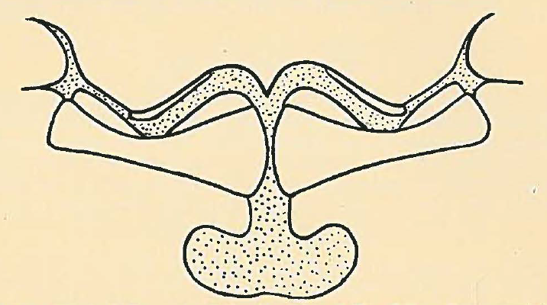
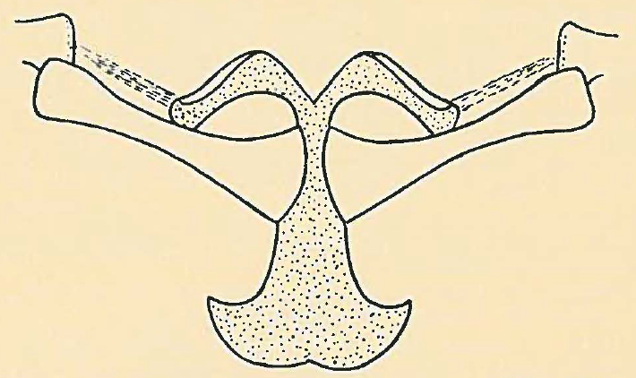
What might be different?
Trait source:
Intergeneric - Boettger 1895
Vomerine teeth
Interspecific - Parker 1934
This study
N=52
Intraorbital width
Tympanum size
Palatal grooves
Palatal ridges
Pupil
Call type
Relative pad size
Shoulder girdle type
Toe lengths
Toe webbing
Diagram from Parker 1934

Slide 23
Two palatal ridges
Scapula to procoracoid connector
Horizontal pupil
Vomerine teeth
5th toe > 3rd toe
IO space > eyelid width
Tympanum: eye diameter
Oreophryne
✓
✓
✓
✓
1/4
ligament
inornata
✓
✓
✓
✓
1/4
ligament
lemur
✓
✓
✓
✓
1/4
ligament
loriae
✓
✓
✓
✓
1/4
cartilage
notata
✓
✓
✓
✓
1/4
ligament
parkeri
✓
✓
✓
✓
1/4
ligament
biroi
Auparoparo
Uninformative
penelopeia
✓
✓
✓
✓
1/4
ligament
insulana
✓
✓
✓
✓
1/4
ligament
phoebe
✓
✓
✓
✓
1/4
cartilage
picticrus
✓
✓
✓
✓
1/3
ligament
matawan
✓
✓
✓
✓
1/4
ligament

Slide 24
Two palatal ridges
Scapula to procoracoid connector
Horizontal pupil
Vomerine teeth
5th toe > 3rd toe
IO space > eyelid width
Toe webbing
Tympanum: eye diameter
Call type
Oreophryne
✓
✓
✓
✓
1/4
ligament
honk
well
inornata
✓
✓
✓
✓
1/4
ligament
honk
basal
lemur
✓
✓
✓
✓
1/4
ligament
honk
well
loriae
✓
✓
✓
✓
1/4
cartilage
peeping
notata
✓
✓
✓
✓
1/4
ligament
peeping
well
parkeri
✓
✓
✓
✓
1/4
ligament
rattle
well
biroi
Auparoparo
Uninformative
Trending
penelopeia
✓
✓
✓
✓
1/4
ligament
whinny
well
insulana
✓
✓
✓
✓
1/4
ligament
whinny
basal
phoebe
✓
✓
✓
✓
1/4
cartilage
whinny
basal
picticrus
✓
✓
✓
✓
1/3
ligament
whinny
basal
matawan
✓
✓
✓
✓
1/4
ligament
peeping
basal

Slide 25
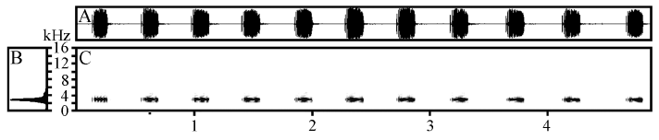
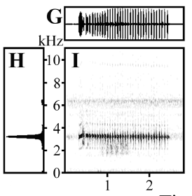
Two palatal ridges
Scapula to procoracoid connector
Horizontal pupil
Vomerine teeth
5th toe > 3rd toe
IO space > eyelid width
Toe webbing
Tympanum: eye diameter
Call type
Oreophryne
✓
✓
✓
✓
1/4
ligament
honk
well
inornata
✓
✓
Honk call:
1/4
ligament
honk
basal
lemur
✓
✓
✓
✓
✓
✓
1/4
ligament
honk
well
loriae
✓
✓
✓
✓
1/4
cartilage
peeping
notata
✓
✓
✓
✓
1/4
ligament
peeping
well
parkeri
✓
✓
✓
✓
1/4
ligament
rattle
well
biroi
Auparoparo
Uninformative
Trending
✓
✓
Whinny call:
1/4
ligament
whinny
well
penelopeia
✓
✓
insulana
✓
✓
✓
✓
1/4
ligament
whinny
basal
phoebe
✓
✓
✓
✓
1/4
cartilage
whinny
basal
picticrus
✓
✓
✓
✓
1/3
ligament
whinny
basal
matawan
✓
✓
✓
✓
1/4
ligament
peeping
basal
Waveform and spectrum graphs from Kraus 2016.

Slide 26
Two palatal ridges
Finger pad vs toe pad size
Scapula to procoracoid connector
Toe webbing
Palate tapering
Horizontal pupil
Vomerine teeth
5th toe > 3rd toe
IO space > eyelid width
Tympanum: eye diameter
Call type
Oreophryne
✓
✓
✓
✓
1/4
ligament
honk
well
inornata
✓
✓
✓
✓
1/4
ligament
honk
basal
lemur
✓
✓
✓
✓
1/4
ligament
honk
well
loriae
✓
✓
✓
✓
1/4
cartilage
peeping
slight
notata
✓
✓
✓
✓
1/4
ligament
peeping
well
parkeri
✓
✓
✓
✓
1/4
ligament
rattle
well
slight
≥
biroi
Auparoparo
Uninformative
Trending
Informative?
penelopeia
✓
✓
✓
✓
1/4
ligament
whinny
well
✓
>
insulana
✓
✓
✓
✓
1/4
ligament
whinny
basal
✓
>
phoebe
✓
✓
✓
✓
1/4
cartilage
whinny
basal
✓
>
picticrus
✓
✓
✓
✓
1/3
ligament
whinny
basal
✓
>
matawan
✓
✓
✓
✓
1/4
ligament
peeping
basal
✓
>

Slide 27
Potentially Informative Traits:
Parallel grooves
Oreophryne
Tapered grooves
Auparoparo

Slide 28
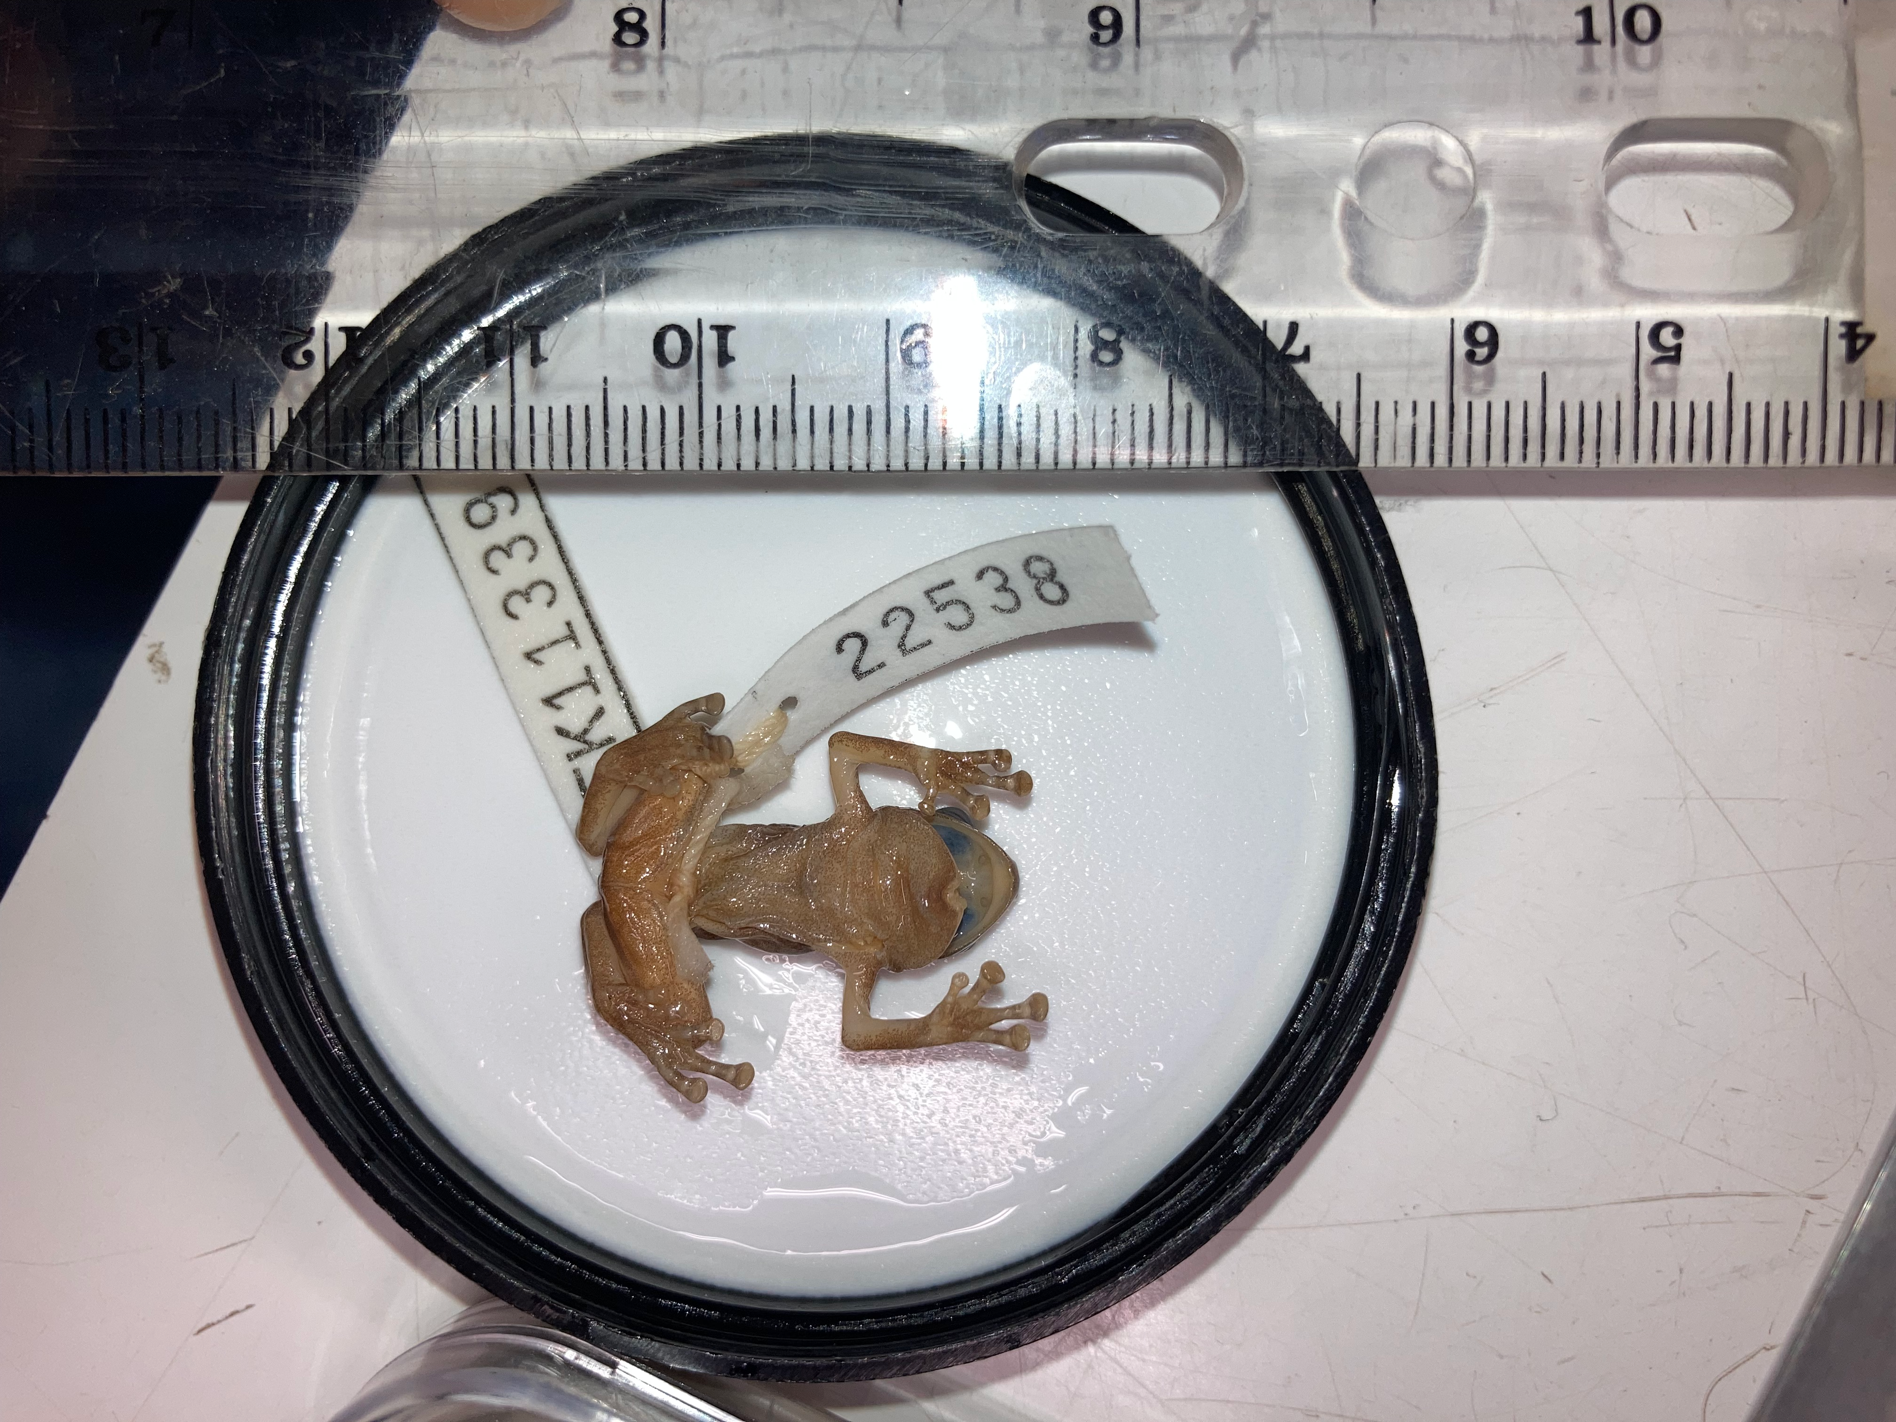
Potentially Informative Traits:
Parallel grooves
3rd finger pad = 4th toe pad
Oreophryne
Tapered grooves
Auparoparo

Slide 29
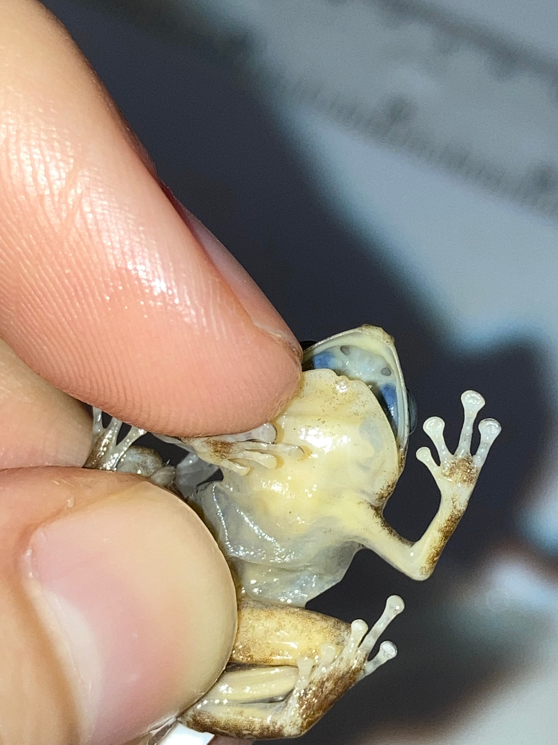
Potentially Informative Traits:
Parallel grooves
3rd finger pad = 4th toe pad
Oreophryne
3rd finger pad > 4th toe pad
Tapered grooves
Auparoparo

Slide 30
Main Differences

Slide 31
Main Differences
Oreophryne
Oldest genus in the subfamily (18MY old)
Widespread distribution
Variable toe webbing
Honk calls
Parallel palate grooves
Finger pads = toe pads

Slide 32
Main Differences
Oreophryne
Auparoparo
Oldest genus in the subfamily (18MY old)
Widespread distribution
Variable toe webbing
Honk calls
Parallel palate grooves
Finger pads = toe pads
More recent (16MY old)
Clustered distribution
Less toe webbing
Whinny calls
Tapered palate grooves
Finger pads > toe pads

Slide 33
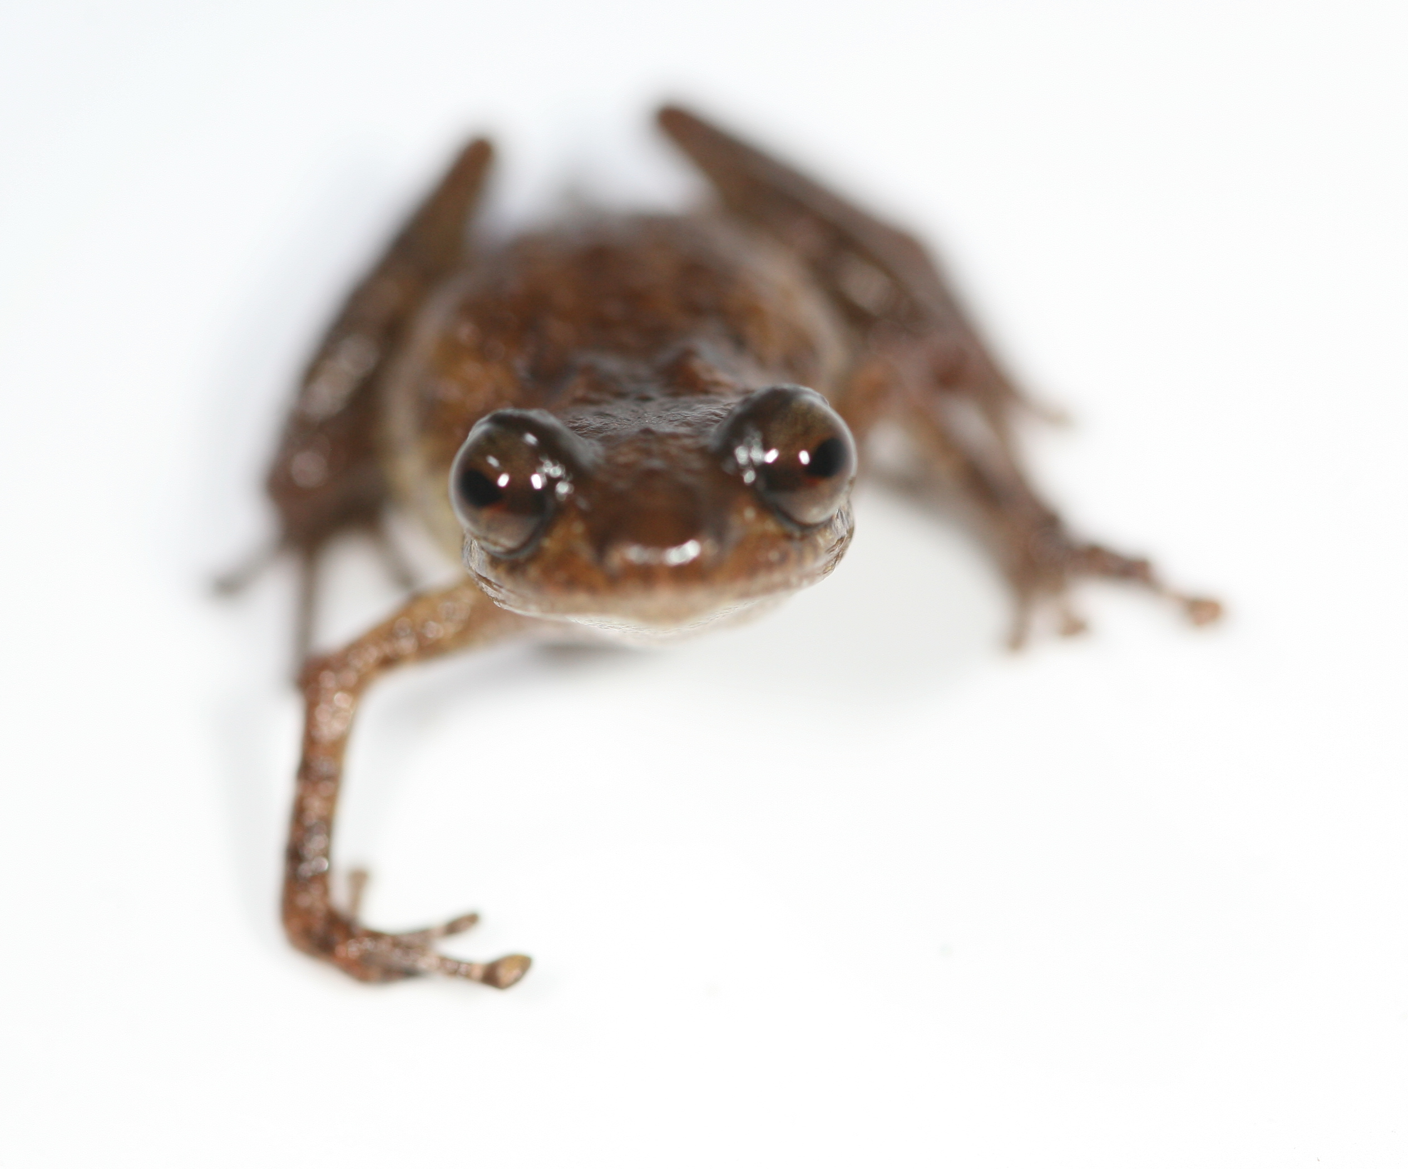
Curiosities
Independent occurrences of arboreal lifestyle
How and why did this happen?
Vicariance - geological influences

Slide 34
Curiosities
Independent occurrences of arboreal lifestyle
How and why did this happen?
Vicariance - geological influences
Cohabitation of highly convergent genera
Low competition?
Nuanced habitat partitioning
Site-based divergence

Slide 35
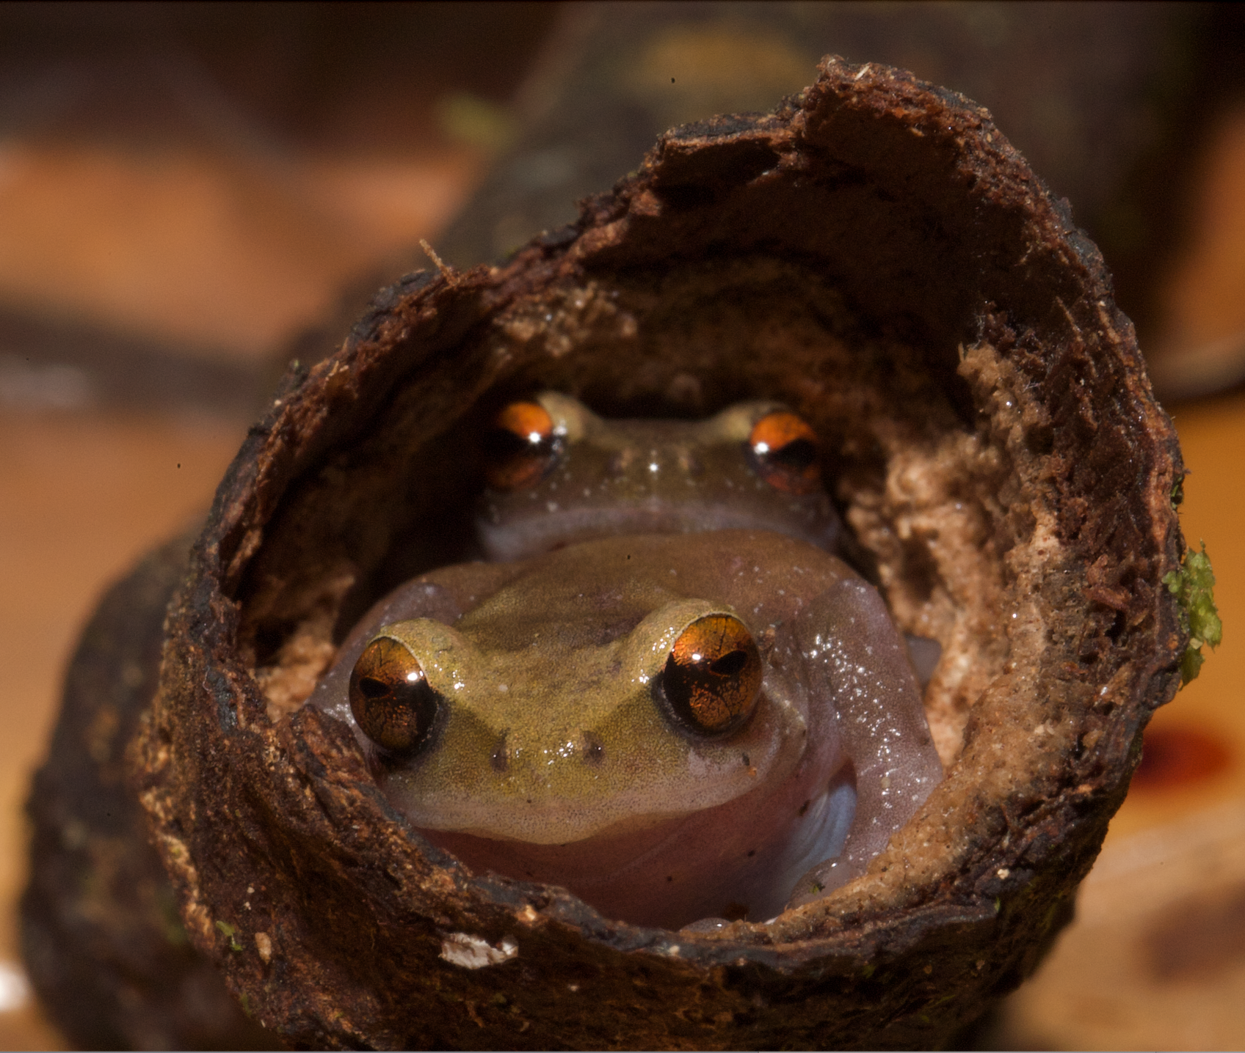
Special Thanks!
Dr. Marguerite Butler
Ke Cao
Dr. Allen Allison
Ethan Hill
Ben Evans
Iqbal Setiadi
Bulisa Iova
Thank you!
Questions?
Image credits:
Dr. Allen Allison
Dr. Marguerite Butler
Ethan C. Hill, Claire J. Fraser, Diana F. Gao, Mary J. Jarman, Elizabeth R. Henry, Bulisa Iova, Allen Allison and Marguerite A. Butler. 2022. Resolving the Deep Phylogeny: Implications for early Adaptive Radiation, Cryptic, and Present-day Ecological Diversity of Papuan Microhylid Frogs. Molecular Phylogenetics and Evolution. 177, 107618. DOI: 10.1016/j.ympev.2022.107618
Google Earth, earth.google.com/web/.
Dr. Fred Kraus
Kraus, F. 2016. Ten new species of Oreophryne (Anura, Microhylidae) from Papua New Guinea. Zootaxa 4195: 1–68.
Parker, H. W. 1934. A Monograph of the Frogs of the Family Microhylidae. London: Trustees of the British Museum.

